Slide 1
PCE as a Central Controller (PCECC)
draft-zhao-pce-pcep-extension-for-pce-controller-05
draft-zhao-pce-pcep-extension-pce-controller-sr-00
draft-palle-pce-controller-labeldb-sync-01
Quintin Zhao | Zhenbin Li | Dhruv Dhody | Satish Karunanithi | Adrian Farrel | Chao Zhou

Slide 2
Overview
Architecture
draft-ietf-teas-pce-central-control-03
WG Last Called
Use-cases
draft-ietf-teas-pcecc-use-cases-01
WG Adopted
An Architecture for Use of PCE and PCEP in a Network with Central Control
The Use Cases for Using PCE as the Central Controller(PCECC) of LSPs
Solutions
Extension to PCEP as per the above architecture and use-cases
Request to WG to consider these solution drafts for adoption

Slide 3
Document Map
draft-zhao-pce-pcep-extension-for-pce-controller-05
Base for PCECC
draft-zhao-pce-pcep-extension-pce-controller-sr-00
Extension for Segment Routing
draft-palle-pce-controller-labeldb-sync-01
Synchronization Optimization procedures
New PCEP Messages/Objects
Label Synchronization
New PCEP Object
Sync Avoidance
Incremental Sync

Slide 4
PCECC
Description
LSPs are provisioned as explicit label instructions at each hop on the end-to-end path.
Each router along the path must be told what label forwarding instructions to program and what resources to reserve.
The controller uses PCEP to communicate with each router along the path of the end-to-end LSP.
Note that the PCE-based controller will take responsibility for managing some part of the MPLS label space for each of the routers that it controls
Section 3.1.2 of draft-ietf-teas-pce-central-control
Section 5 of draft-ietf-teas-pcecc-use-cases-01
It may taker wider responsibility for partitioning the label space for each router and allocating different parts for different uses.

Slide 5
PCECC - SR
Use PCEP protocol for SR label distribution when PCE is managing the label space.
PCE as a central controller can allocate and provision the node/adjacency label (SID) via PCEP.
Description
Section 3.1.5 of draft-ietf-teas-pce-central-control
Section 4 of draft-ietf-teas-pcecc-use-cases
In some deployments PCE (and PCEP) are better suited than IGP because of centralized nature of PCE and direct TCP based PCEP session to the node.
The Label Map are updated on all PCEP sessions.
In case of redundant PCEs, label should be synchronized.

Slide 6
PCEP extension
Capability
Advertise PCECC capability in Open
Label Download
Label allocated by PCE
Label-DB Synchronization
Label Map
Label allocated by PCE for SR (node, prefix, adj)
PCLabelUpd to advertise the label mapping on all sessions.
A new PCEP message PCLabelUpd to download label instructions on each node.
Session Termination
PCC marks all labels on the session as stale.
Stale labels are cleared on state timeout interval.
For SR labels, PCC should find alternative PCE to delegate the orphan labels.
First, PCE synchronize its LABEL-DB to PCC.
Second, PCC reports all the stale marked labels to PCE.

Slide 7
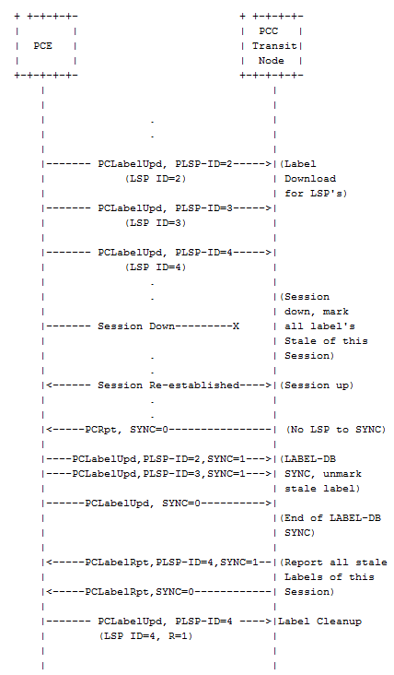
Label DB Synchronization
At PCC all labels are marked stale that were previously reported by this PCE on session down.
LABEL-DB synchronization is a two phase procedure.
In first phase, immediately after the LSP state synchronization PCE MUST synchronize its LABEL-DB to PCC.
In second phase, PCC MUST report all the stale marked labels to PCE using PCLabelRpt message.
PCE decide to delete or keep this label entries and inform PCC using PCLabelUpd Message and PCC will remove the stale marking for the all labels on receipt of corresponding PCLabelUpd message.
In case of PCECC SR, if PCC has any alternate PCEP session with another PCE, then PCC MUST delegate the SR labels of this session to this alternate PCE in a sequence of PCLabelRpt message. PCE can accept it and can send PCLabelUpd message to update or clean the label.

Slide 8
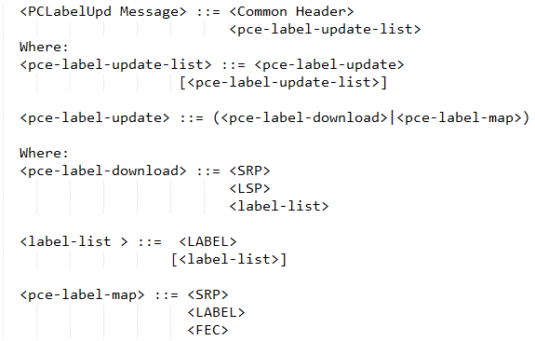
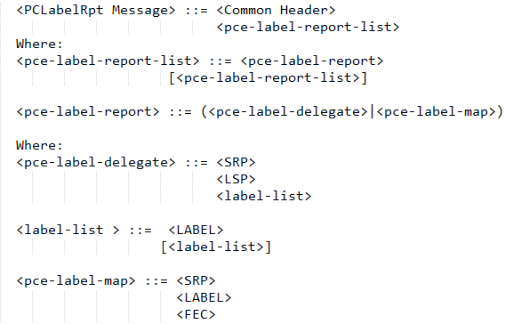
PCEP Messages
Label Update
Label Report

Slide 9
Next Step
Implementation Exists
As part of Hackathon and Bits n Bytes
Reviews welcome!
Request for WG adoption

Slide 10


